Slide 1
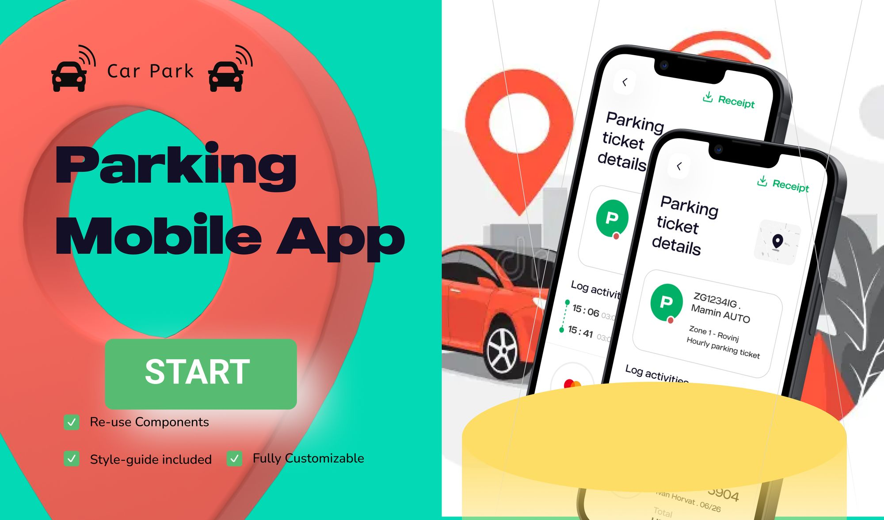
Revolutionizing Urban Parking
with IoT

Slide 2
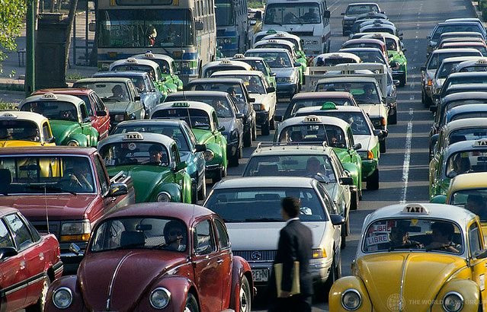
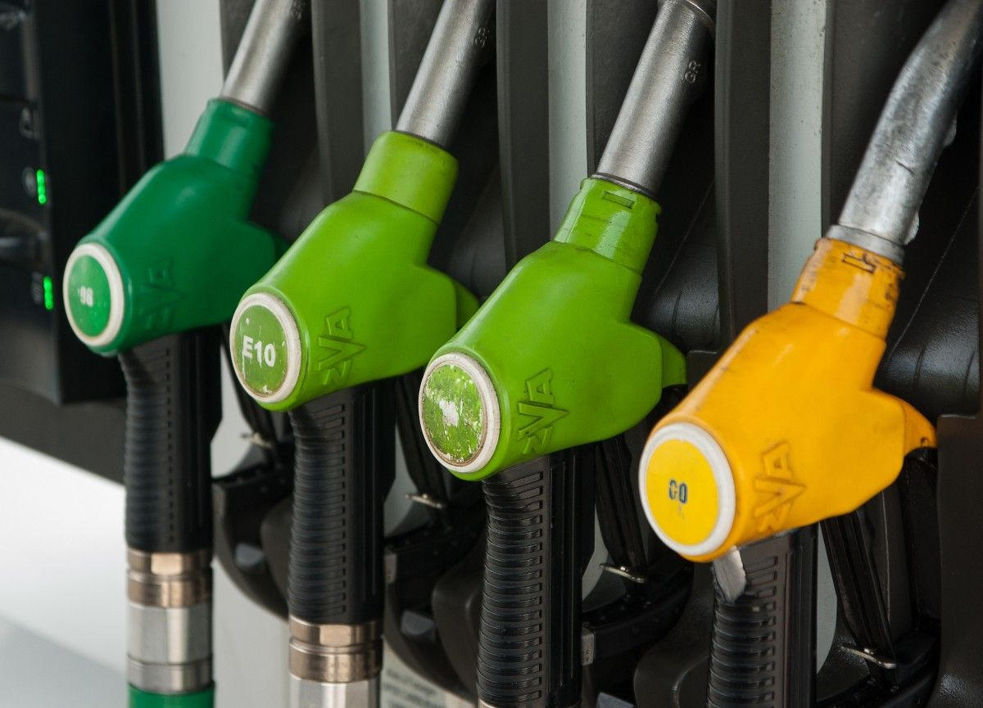
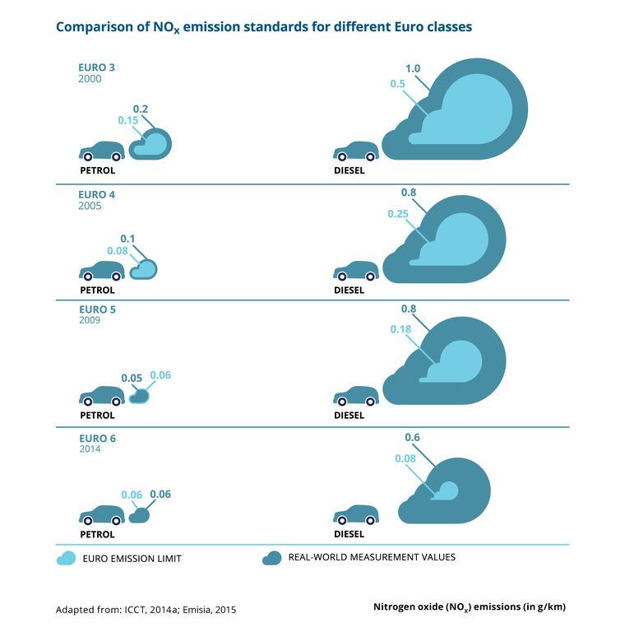
The Urban Parking Challenge: A Gridlock of Problems
Traffic Congestion
Fuel Waste
Environmental Impact
Finding parking in bustling cities often leads to endless circling, wasting precious time and fuel. This congestion contributes to increased air pollution and frustration for drivers.
The search for parking can consume a significant amount of fuel, adding to environmental impact and driving costs. It's a hidden expense that drivers often overlook.
Increased CO₂ emissions from unnecessary idling and driving
According to studies, 30% of urban traffic is caused by vehicles searching for parking spots, which contributes to air pollution and driver frustration

Slide 3

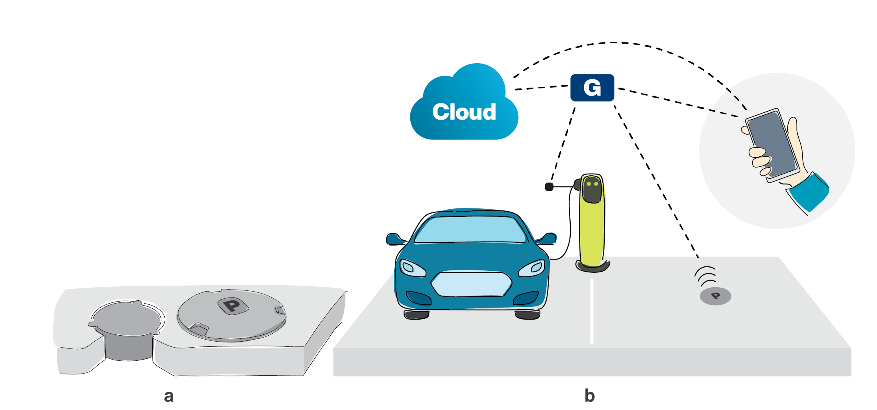
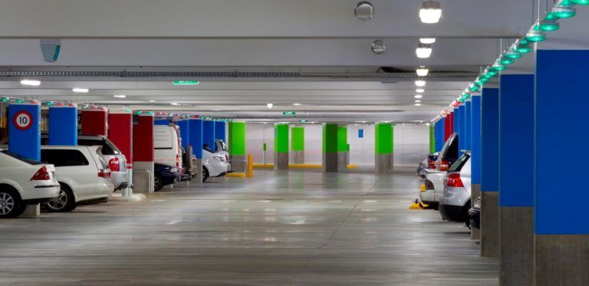
Introducing Our IoT-Enabled Smart Parking Solution
1
Real-Time Parking Data
2
Mobile App Integration
Our network of IoT sensors monitors parking spaces in real-time, providing accurate availability information to drivers.
A user-friendly mobile app leverages this data, guiding drivers to open spots and streamlining parking processes.
3
Seamless User Experience
The app simplifies parking reservations, payment, and access, making the entire experience convenient and efficient.

Slide 4

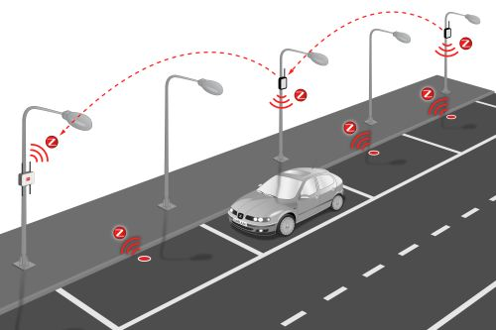



Real-Time Parking Availability with IoT Sensors
Sensor Network
Data Aggregation
Mobile App Interface
Smart sensors strategically placed throughout parking garages and lots provide real-time data on available parking spaces.
Sensor data is collected and aggregated in a centralized platform, providing a comprehensive view of parking availability.
Provides real-time updates, reservation capabilities, and navigational support

Slide 5
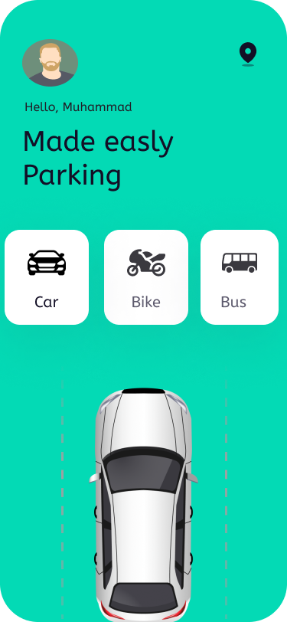
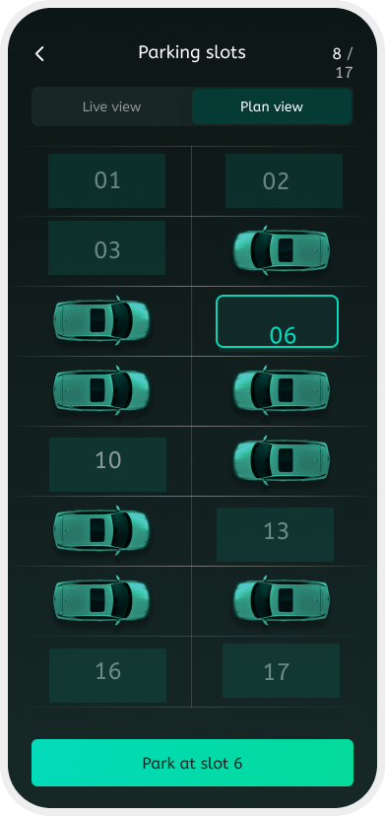



Seamless Parking Booking and Payment via Mobile App
Discover Parking
Drivers use the app to search for available parking spaces in their desired location.
Reserve Your Spot
The app allows drivers to easily reserve a parking spot, guaranteeing their space and eliminating the stress of searching.
Secure Payment
Convenient and secure payment options are integrated within the app, allowing drivers to pay for their parking in advance.

Slide 6
Onboarding: Guiding Users to Discover and Use the App
Account Setup
1
New users create an account and enter their vehicle information for seamless identification.
Location Permissions
2
The app requests location access to provide accurate parking recommendations based on the user's location.
Slot Booking
3
User can book the availability slots in the precise location and check the availbility of slot timings to book .
Payment Integration
4
Users securely link their preferred payment method for quick and convenient transactions.

Slide 7
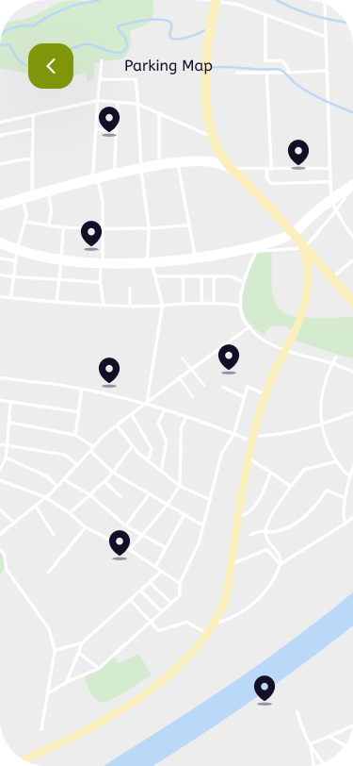
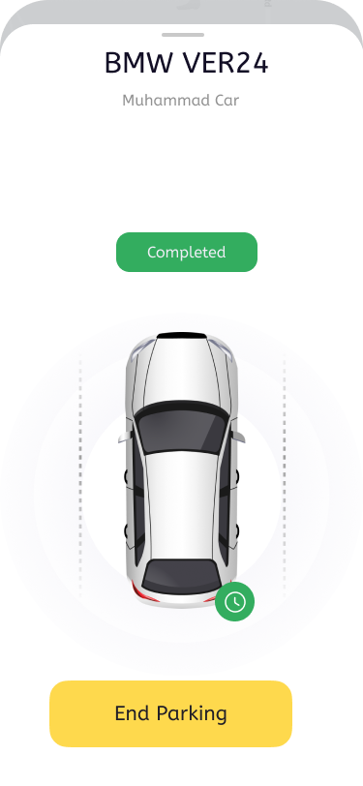
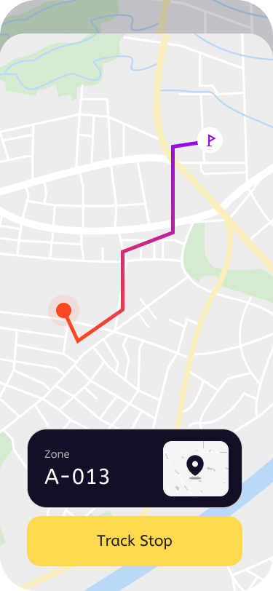
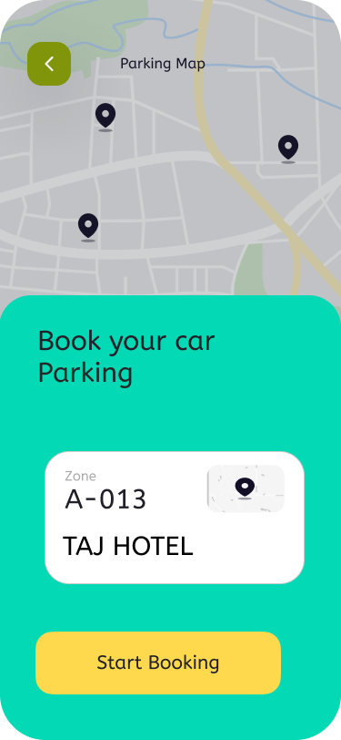
Parking Selection: Identifying Open Spots in Your Area
Interactive Map
Filtered Search
The app's map interface visually displays available parking spaces in real-time, with color-coded indicators for different types of parking.
Users can filter their search by price, distance, parking type (covered, outdoor, etc.) to find their ideal spot.

Slide 8
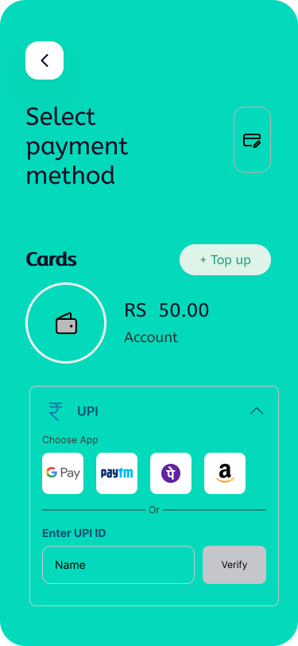
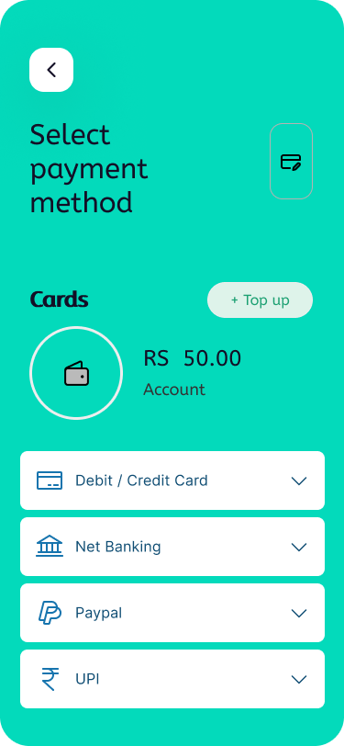
Reservation and Payment: A Streamlined User Experience
1
Select Spot
Drivers choose their preferred parking space from the available options and view the parking details and price.
2
Confirm Booking
The app confirms the booking details and presents the user with a clear overview of the reservation.
3
Secure Payment
Drivers securely enter their payment information using the app's integrated payment gateway.

Slide 9
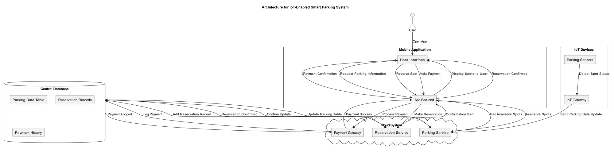



Technical Architecture: Integrating IoT, Cloud, and Mobile
IoT Sensors
1
Sensors gather real-time parking data and transmit it to the cloud.
Cloud Platform
2
The cloud platform aggregates sensor data, manages user accounts, and processes payments.
Mobile App
3
The mobile app connects to the cloud platform, providing users with parking information, booking, and payment services.

Slide 10
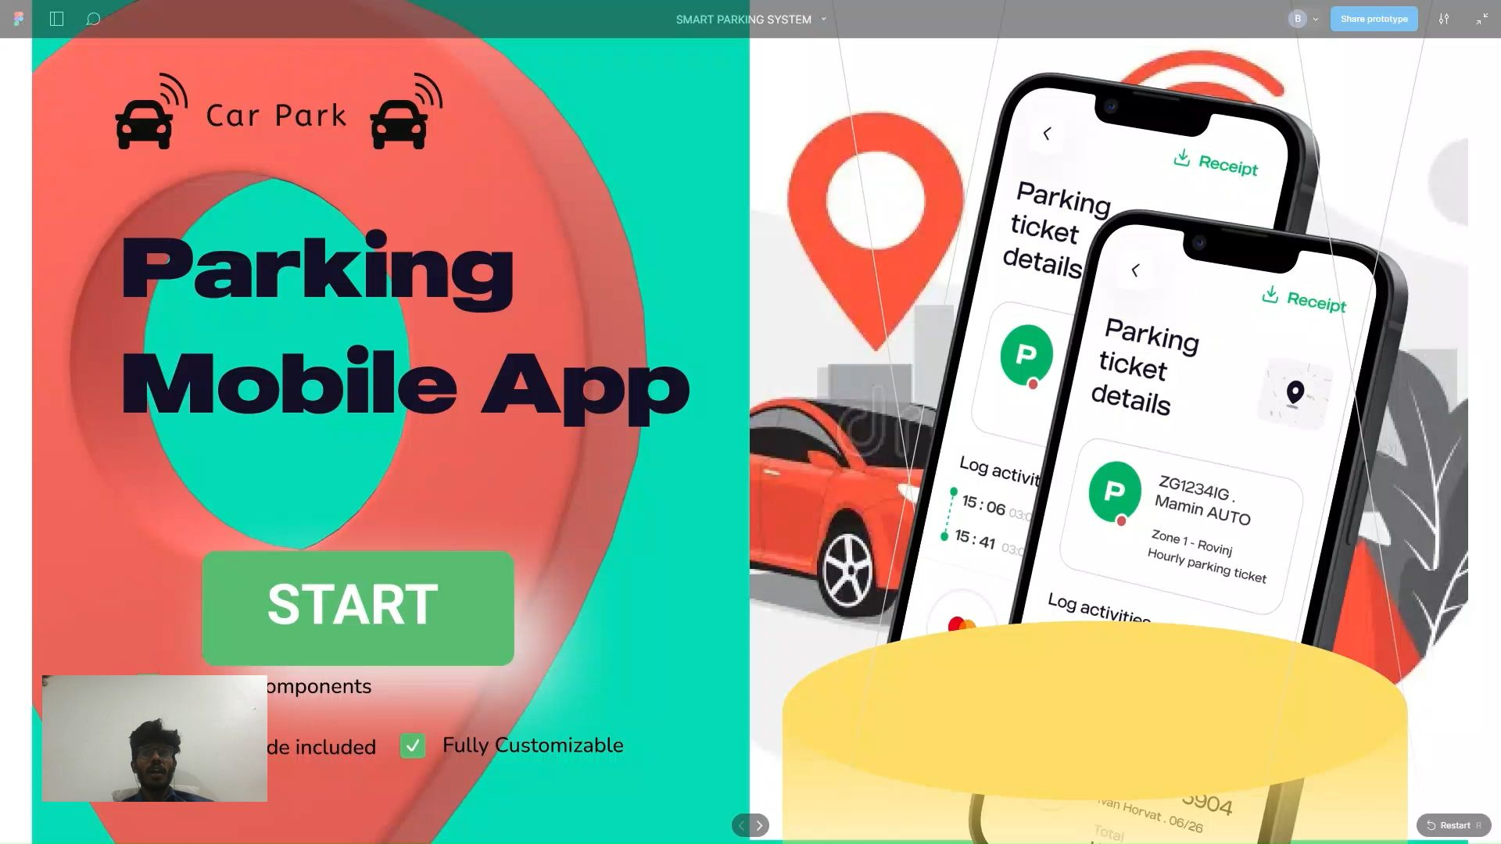
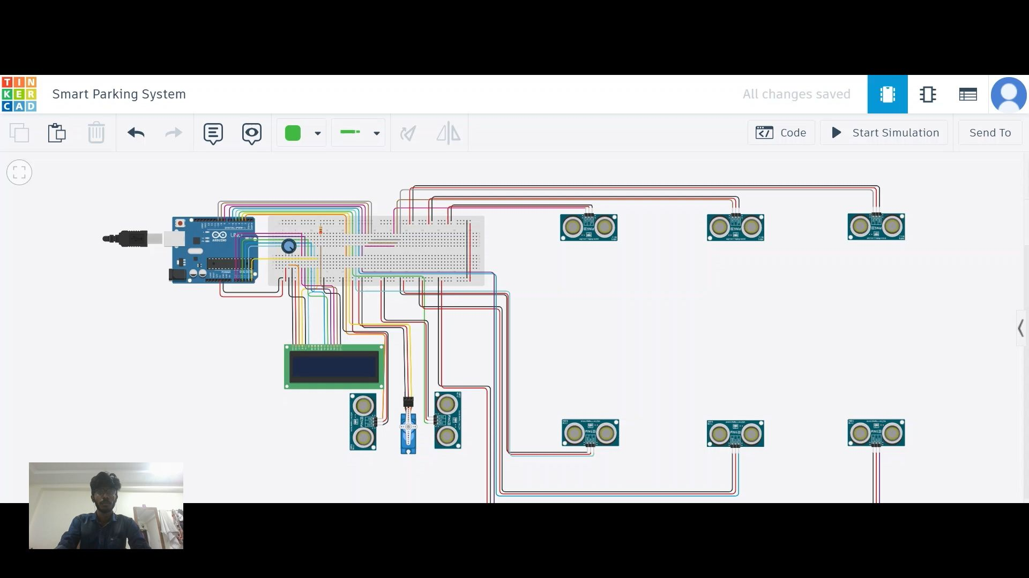
Live Demo: Showcasing the Smart Parking User Journey
By video
APP DESIGN (UI/UX INTERFACE) WORKING MODEL
IOT DEVICES MODEL BY THINKERCAD

